Slide 1
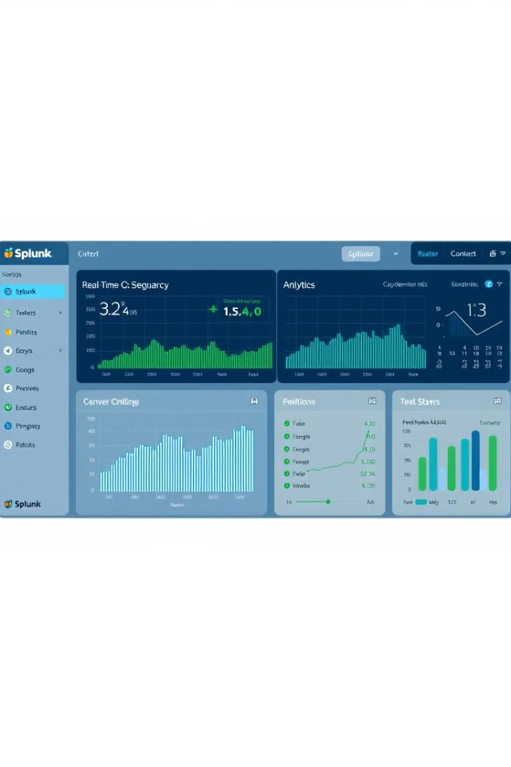


Unlocking Insights: Mastering Splunk Searching
Welcome to the world of Splunk searching! Splunk is a powerful data analytics platform.
Efficient searching is critical for data analysis, so you can get faster insights.
Let’s dive into basic and advanced search options with examples to get you started.
by Trupthi Shetty

Slide 2
Fundamentals of Splunk Search Syntax
The Splunk search processing language (SPL) is key.
Commands, functions, and operators are all part of SPL.
Use search, index, sourcetype, and host to find what you need.
Combine them with AND, OR, and NOT for precision.
Index
Sourcetype
Specify the index to search.
Filter events by source type.
Example: index=main
Example: sourcetype=apache_access

Slide 3




Filtering and Precise Field Extraction
Use the where command for advanced filtering of events.
The rex command extracts fields using regular expressions.
The extract command pulls fields based on key-value pairs.
Refine
Extract
Modify
Filters events based on conditions.
Pulls specific data from events.
Adjust field values as needed.

Slide 4

Transforming Data into Actionable Reports
Use the stats command for data aggregations. Functions like count and sum are helpful.
The timechart command supports time-series analysis. Functions like avg() and sum() help.
Generate reports with table and fields, and make visuals with charting commands.
Aggregate
Analyze
Summarize data for key insights.
Examine trends over time.
Visualize
Create clear, concise reports.

Slide 5




Elevating Searches with Advanced Techniques
Use subsearches for dynamic filtering, enriching events with criteria.
Lookups enrich data with external data. Configuration in transforms.conf and props.conf.
The transaction command groups related events based on criteria.
Subsearches
Lookups
Transactions
Dynamically filter events.
Enrich data with external info.
Group related events.

Slide 6
Real-Time Web Server Monitoring Example
Monitor web server logs for errors and performance issues to protect servers.
Use Apache or Nginx logs as your data source.
The Goal: Identify error spikes, slow response times, and malicious activity.
Basic search: index=web sourcetype=apache_access status_code>=500.
Collect
Identify
Gather web server logs.
Detect error spikes, and activity.
1
2
3
Analyze
Check for high status codes.

Slide 7






PLANNING TO MOVE INTO IT?
​Thinkcloudly offers 32+ IT Programs, including AWS, Azure, Cybersecurity, Data Analytics, and many more.
+1 (646) 980-6267
Contact Mr. Naman Jain
Send a message on WhatsApp or Call him directly.
5

